Slide 1
POWER-EFFICIENT RANGE-MATCH-BASED PACKET CLASSIFICATION ON FPGA
Authors: | Yun R. Qu, Viktor K. Prasanna
Publisher: | 2015 25th International Conference on Field Programmable Logic and Applications (FPL)
Presenter: | Chun-Yu, Li
Date: | 105/10/5
Notes:
這篇主要提出的power efficient，是我們pipeline架構常見的一個現象，前面已經不符合某個條件下，那後面的比對也不用再進行
所以他們用的方法是關掉後面不用進行比對的memory module，後面有一些數據是我們可以參考的

Slide 2
INTRODUCTION
We construct a modular PE to match a stride of the packet header against a stride of a range boundary (A naïve approach to match ranges is to deploy a W-bit comparator for each range boundary).
We concatenate multiple PEs into a systolic array to sustain high clock rates for large rule sets.
We employ a self-enabled power gating technique on our architecture. The modular PEs are selectively enabled to save the memory access power.
Notes:
每一個PE就是一個s-bit的comparator，如果是upper bound，就用小於等於的comparator，如果是lower bound，就用大於等於的comparator，
當然也可以直接做全部bit的比對，但是實作上就會出現電路比較慢的情形。
最後所有的PE會串成systolic array來進行比對(這個架構後面會看到)
這是剛剛提到的，後面不用進行比對的memory module，他們會用clock gating的方式去關掉memory省電。

Slide 3
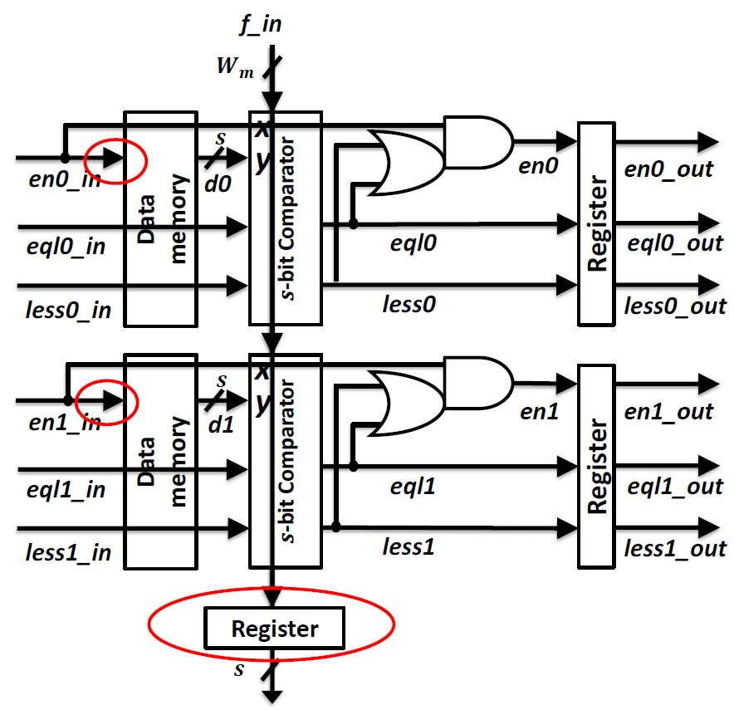
MODULAR PROCESSING ELEMENT
s: s-bit stride.
c: number of range boundaries compared by a modular PE.
PE consist of c data memory module, c comparators.
c = 2
$≤$ comparator
eql0_in | less0_in | x & y | eql0 | less0 | en0
0 | 0 | * | 0 | 0 | 0
0 | 1 | * | 0 | 1 | en0_in
1 | * | x=y | 1 | * | en0_in
 |  | x<y | 0 | 1 | en0_in
 |  | x>y | 0 | 0 | 0
Notes:
1.解釋一個PE處理s bit, c boundaries
2.解釋小於等於的comparator
3.解釋紅圈

Slide 4
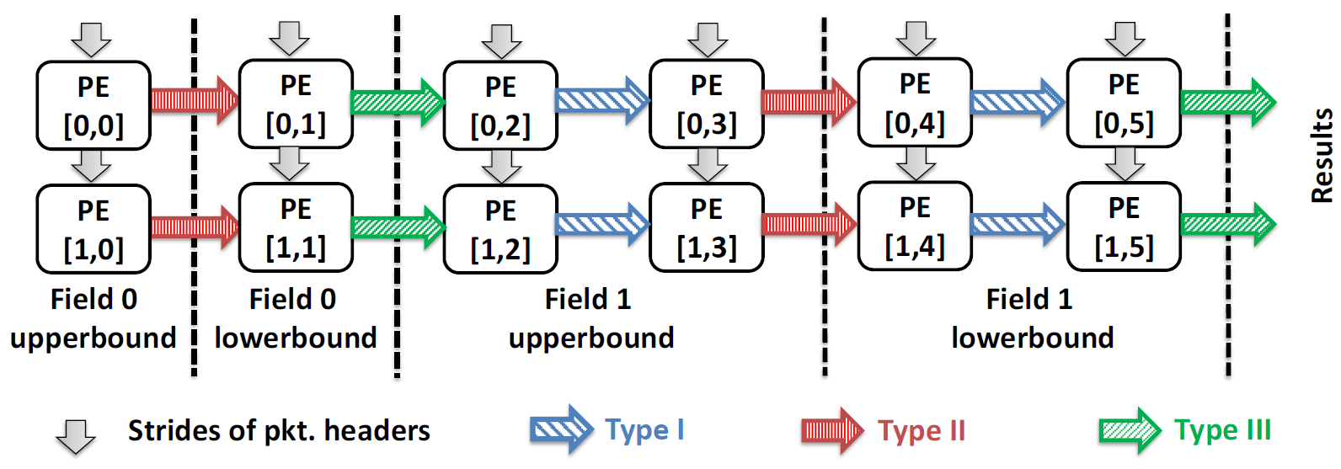
SYSTOLIC ARRAY
The strides from the input packet headers are propagated vertically. Each column of PEs compares an s-bit input stride with the corresponding strides of all the N rules.
The number of rows required for N rule is $\left\lceil \frac{N}{c}\right\rceil$, while the total number of columns required for ($\sum{W_{m}}$)–bit packet is $2∙\sum{\left\lceil \frac{W_{m}}{s}\right\rceil }$.
Notes:
所以我們可以看到所有的PE會串成這種SYSTOLIC ARRAY的架構，這個架構是Decomposition based，比對完某一維度，再比對下一個維度。
每個維度有各自的upperbound、lowerbound比對。
所以有幾個row就取決於一個PE可以處理多少rule，總共需要幾個row做處理。從column來看的話，就是 所有要進行比對的bit數除與stride數，乘與2是因為需要upperbound跟lowerbound的比對

Slide 5
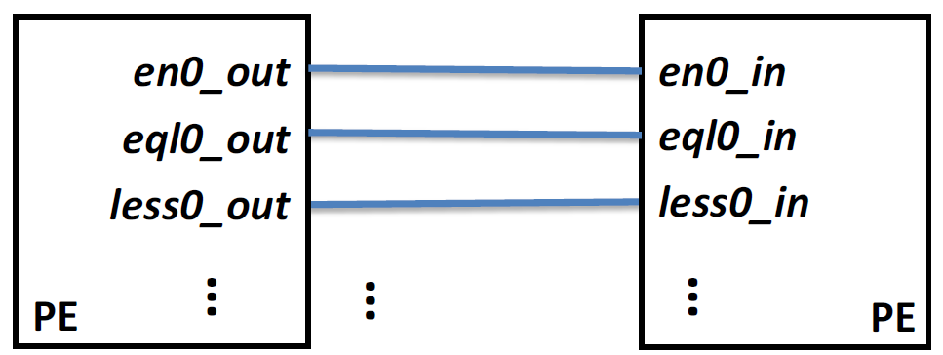
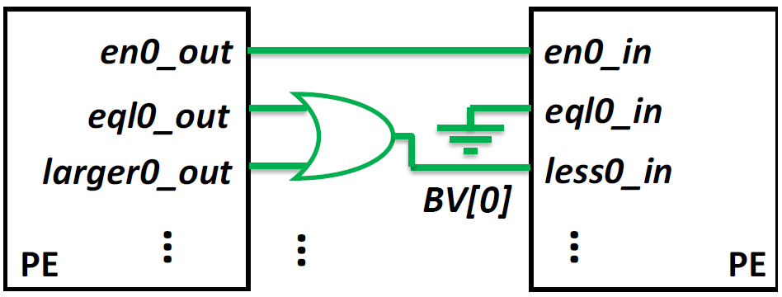
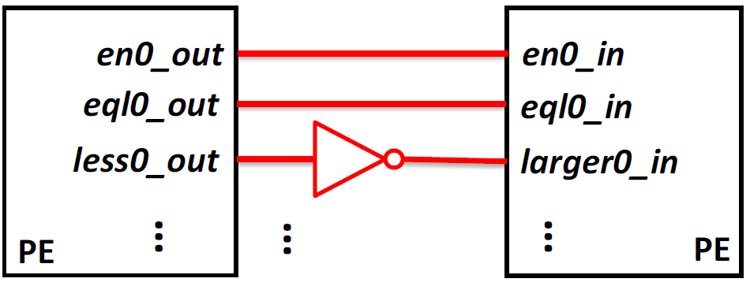
SYSTOLIC ARRAY
(Type I) for the same field, both comparing upperbounds/lowerbounds
(Type III) for different fields
(Type II) for the same field, one comparing upperbound but the other comparing lowerbound
Notes:
那接線之間會有三種type，如果是同一種

Slide 6
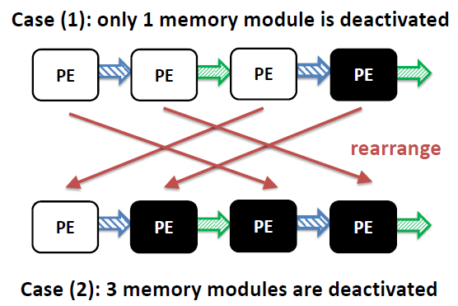
SELF-ENABLED POWER GATING
Chaining: If one data memory module is deactivated, a chain of data memory modules in the following PEs will be deactivated.
To make the self-enabled power gating more effective, for a given packet header and a given rule, we need to report the mismatch, if any, as early as possible

Slide 7
ENTROPY-BASED SCHEDULING
Number of bits in field $m$ as $W_{m}$, where $m=0,1,…,M−1$
A range in field m may cover multiple values in $[0,2^{W_{m}})$
Number of occurrences for value $k^{(m)}$ in field $m$ as $f_{k^{(m)}}$
The probability that an input value $k^{(m)}$ matches some rules in field $m$ is $p_{k^{(m)}}=\frac{f_{k^{(m)}}}{\sum_{k^{(m)}}{f_{k^{(m)}}}}$
The entropy of field $m$ is given: $H\left(m\right)=−\sum_{k^{(m)}}{[ p_{k^{\left(m\right)}}∙log p_{k^{\left(m\right)}} ]}$
Schedule all the fields in descending order of $H(m)$, a field with higher entropy reveals more information; thus, such a field should be matched early to identify mismatches.

Slide 8
PERFORMANCE EVALUATION
We conducted experiments on the state-of-the-art Xilinx Virtex 7 FPGA (XC7VX1140T).
We evaluated the performance using Xilinx Vivado 2014.2.
We set a conservative clock constraint of 250MHz for all of our designs.
We reported resource utilization and clock rate using post-place-and-route reports.
For power estimation; we used Switching Activity Interchange Format (SAIF) files as inputs to Vivado power analysis tool.
We built synthetic rule sets where the entropy of each field could be adjusted separately.

Slide 9
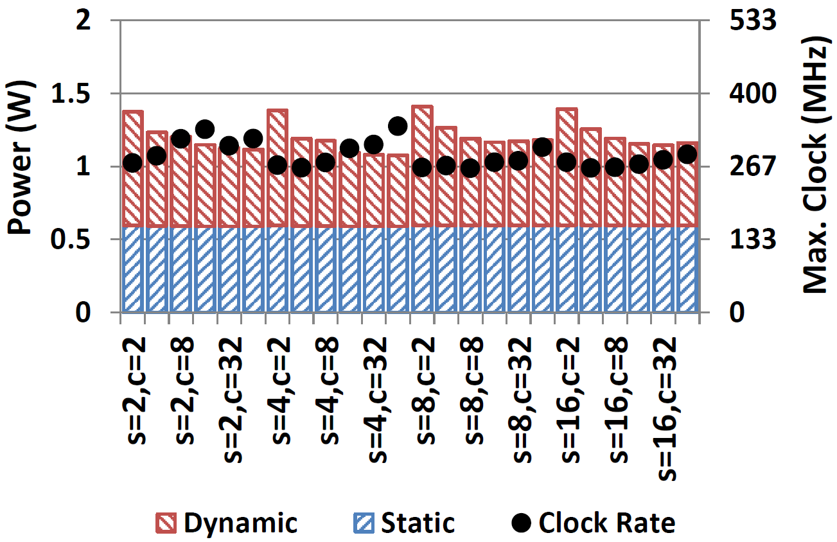
PERFORMANCE EVALUATION
Fix the packet header length $\sum{W_{m}=64}$ and the number of rule N = 128.
Vary $s=2, 4, 8, 16$, and $c=2, 4, 8, 16, 32, 64$.
The performance of $s=4$ and $c=64$ is best.

Slide 10
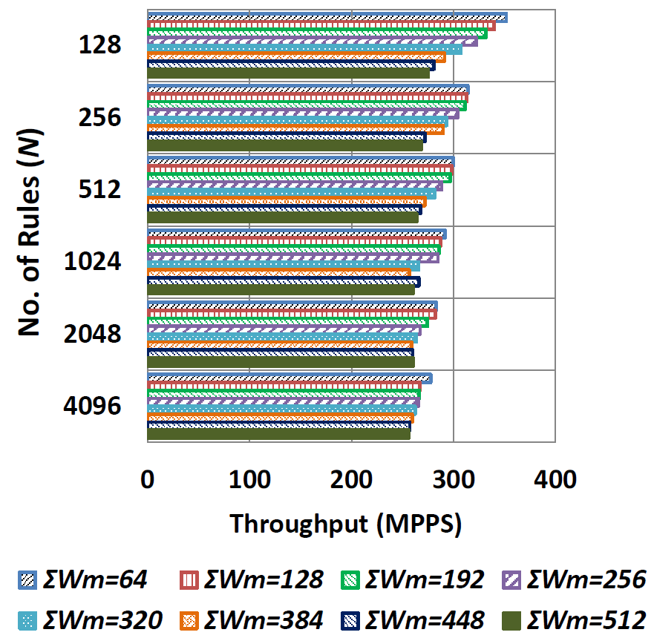
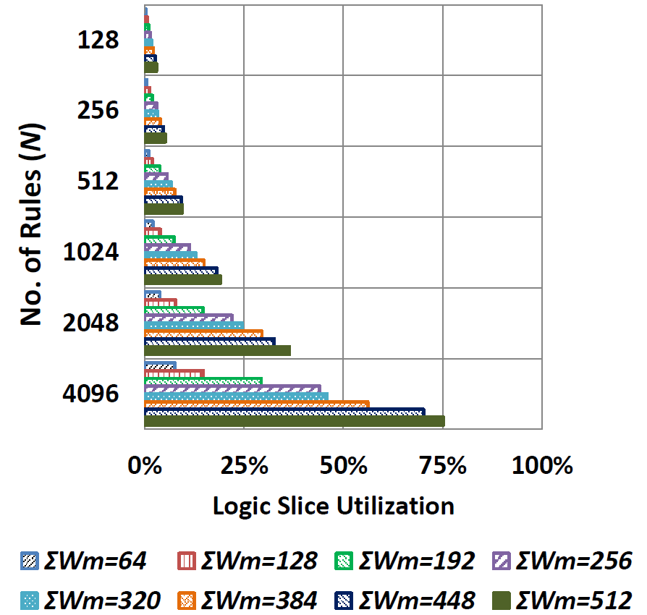
PERFORMANCE EVALUATION
Our designs on FPGA sustains > 250 MPPS throughput even for 4K 512-bit rules.

Slide 11
PERFORMANCE EVALUATION
We show the power performance with respect to N, for the classic packet classification (M = 5) and the OpenFlow table lookup (M = 15) under three scenarios:
Without any power optimization technique.
With self-enabled power gating, but randomly scheduling of packet header fields.
With self-enabled power gating along with entropy-based scheduling of packet header fields.
To see the effect of random scheduling, we run 100 tests for a fixed pair of $M$ and $N$. For each test, the power consumption is averaged on 1K random packets.

Slide 12
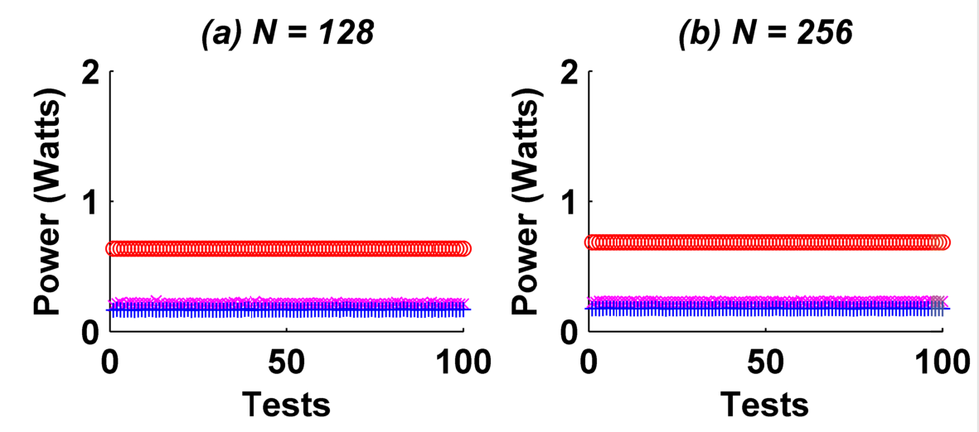
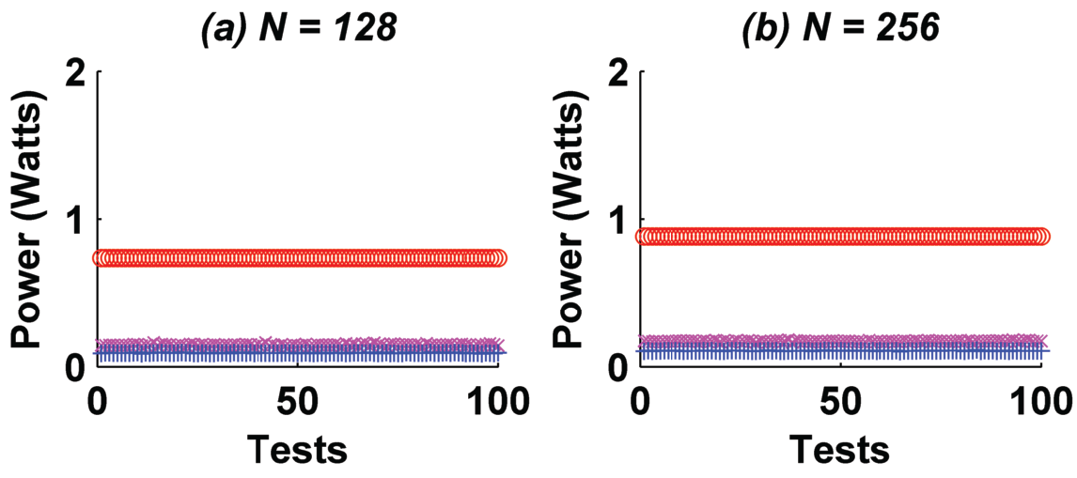
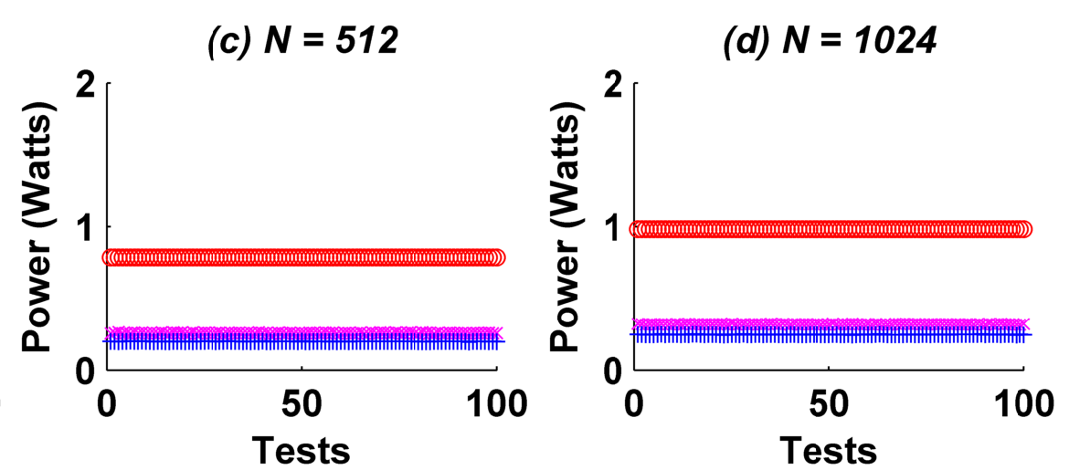
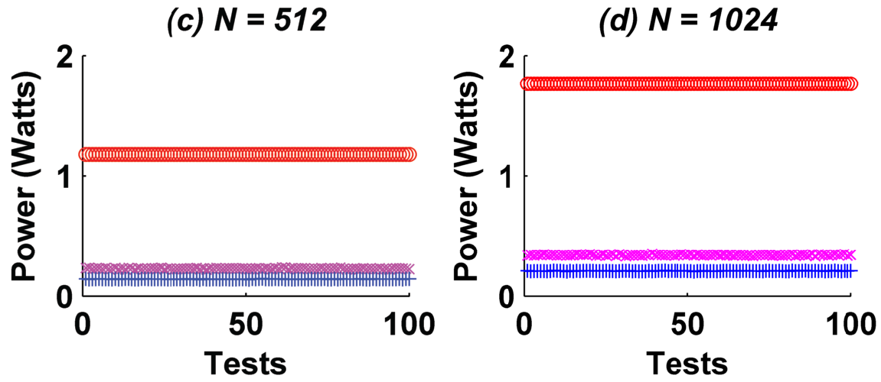
PERFORMANCE EVALUATION
Self-enabled power gating reduces the average power consumption by 60%.
Exploiting both optimization reduces the average power consumption further by 20%.
red “o”: no optimization
pink “x”: self-enabled power gating
blue “+”: both optimization

